Slide 1
第31組 (E)小題報告
劉邦均107501525
羅世辰107501526
吳叡青107501534

Slide 2
E. 分析快速排序演算法最差狀況空間複雜度(worst case space complexity)。

Slide 3
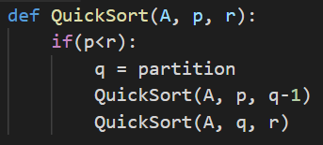
QuickSort 使用遞迴法來實作 -> Call Stack
Consider a worst case scenario e.g. a sorted array
1 | 2 | 3 | 4 | 5 | 6 | 7 | 8 | 9
Pivot

Slide 4
1 | 2 | 3 | 4 | 5 | 6 | 7 | 8 | 9
1:
2:
3:
4:
QuickSort(A, p = 1, r = 9)
q = 9 Line:3
Stack
QuickSort(A, p = 1, r = 2)
q = 2 Line:3
n-1個
Function Call
QuickSort(A, p = 1, r = 8)
q = 8 Line:3
Depth: n-1
QuickSort(A, p = 1, r = 7)
q = 7 Line:3
QuickSort(A, p = 1, r = 8)
q = 8 Line:3
QuickSort(A, p = 1, r = 9)
q = 9 Line:3

Slide 5
Space Complexity Explain
Stack
QuickSort(A, p = 1, r = 2)
q = 2 Line:3
f(n) = c*(n-1) ≤ cn = cg(n)
-> f(n) = c*(n-1) = O(g(n)) = O(n)
Depth: n-1
Each cell has c constants
QuickSort(A, p = 1, r = 8)
q = 8 Line:3
QuickSort(A, p = 1, r = 9)
q = 9 Line:3

Slide 6
參考資料
https://www.youtube.com/watch?v=KSQdRBxRE0w (必看)
https://alrightchiu.github.io/SecondRound/comparison-sort-quick-sortkuai-su-pai-xu-fa.html

